Slide 1

VISUAL CRYPTOGRAPHY
Sandeep Lanka

Slide 2
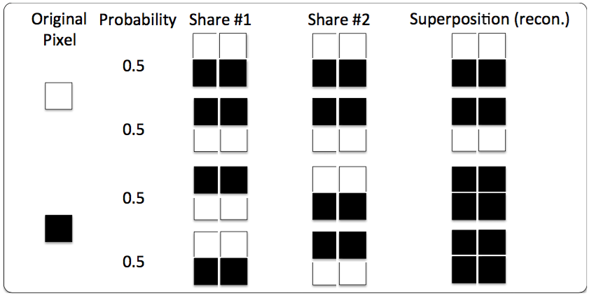
INTRODUCTION
Visual Cryptography is a secret sharing technique
The original Image is reconstructed by superimposing the two shares one over another.
Each pixel is encoded with four sub-pixels. This maintains the same aspect ratio of the original Image.

Slide 3
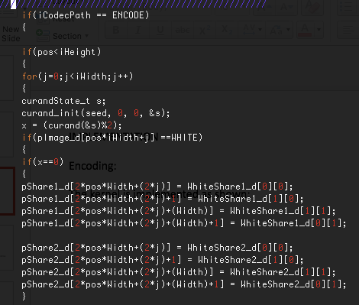
IMPLEMENTATION
Encoding:
Each Row is assigned a thread.
The kernel is implemented as shown:

Slide 4
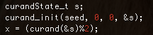
Random Number Generation
CUDA curand function is used to generate random states.
The implementation :
For the Seed “pos” is used which is the thread index in my program.
This produces random 1’s and 0’s which is used to determine the share that is to be assigned for randomness

Slide 5
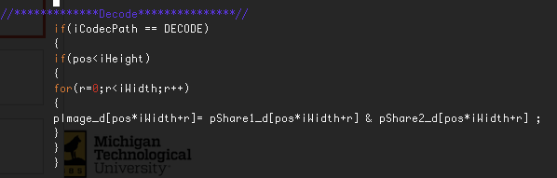
The Decoding is implemented as shown here
Good Configuration of the Grid and Block sizes gives good performance. In order to find the best Configuration
The Compiled code is run for the biggest image using the same number of threads but different configurations and the timings are observed.

Slide 6
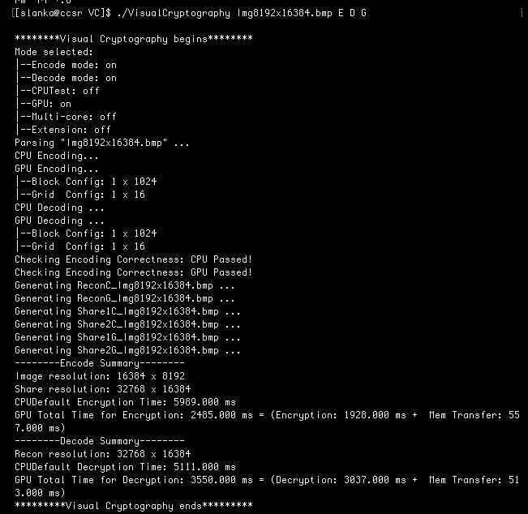

Slide 7
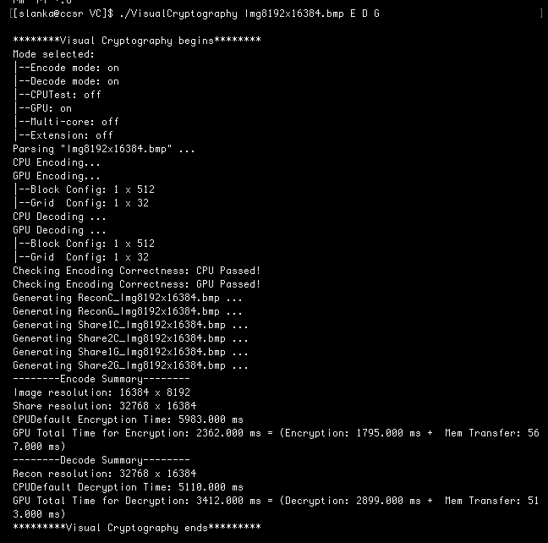

Slide 8


Slide 9
The Encryption and the Decryption time for different Configurations for the Image Img8192x16348.bmp:
Configurations | Total Encryption Time | Encryption Time | MemTransfer Time | Total Decryption Time | Decryption Time | Mem Transfer Time
1024x16 | 2485 | 1928 | 557 | 3550 | 3037 | 513
512x32 | 2362 | 1795 | 567 | 3412 | 2899 | 513
256x64 | 2302 | 1734 | 568 | 3417 | 2899 | 518
128x128 | 2225 | 1656 | 569 | 3392 | 2877 | 515
64x256 | 2183 | 1618 | 565 | 3403 | 2868 | 53
32x512 | 1879 | 1282 | 597 | 3129 | 2606 | 523
16x1024 | 1628 | 1052 | 576 | 1649 | 1138 | 51
8x2048 | 1241 | 653 | 588 | 1359 | 833 | 526
4x4096 | 1078 | 498 | 580 | 1372 | 834 | 538
2x8192 | 1185 | 632 | 553 | 1355 | 819 | 536

Slide 10
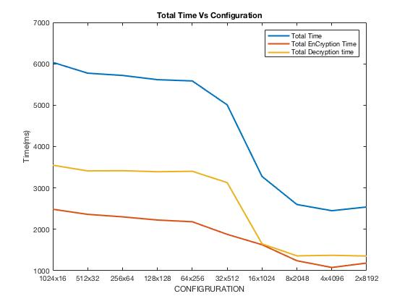
This analysis is carried out on all combinations keeping the number of threads constant :

Slide 11
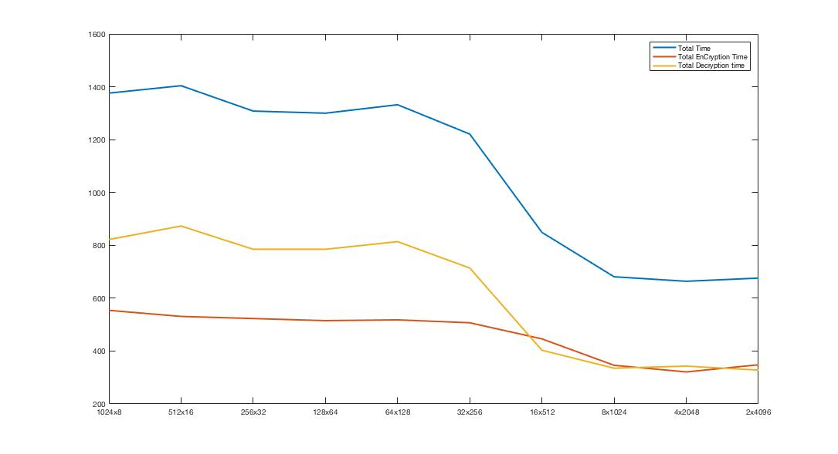
The same analysis is carried out on all combinations of Img4096x8192.bmp

Slide 12
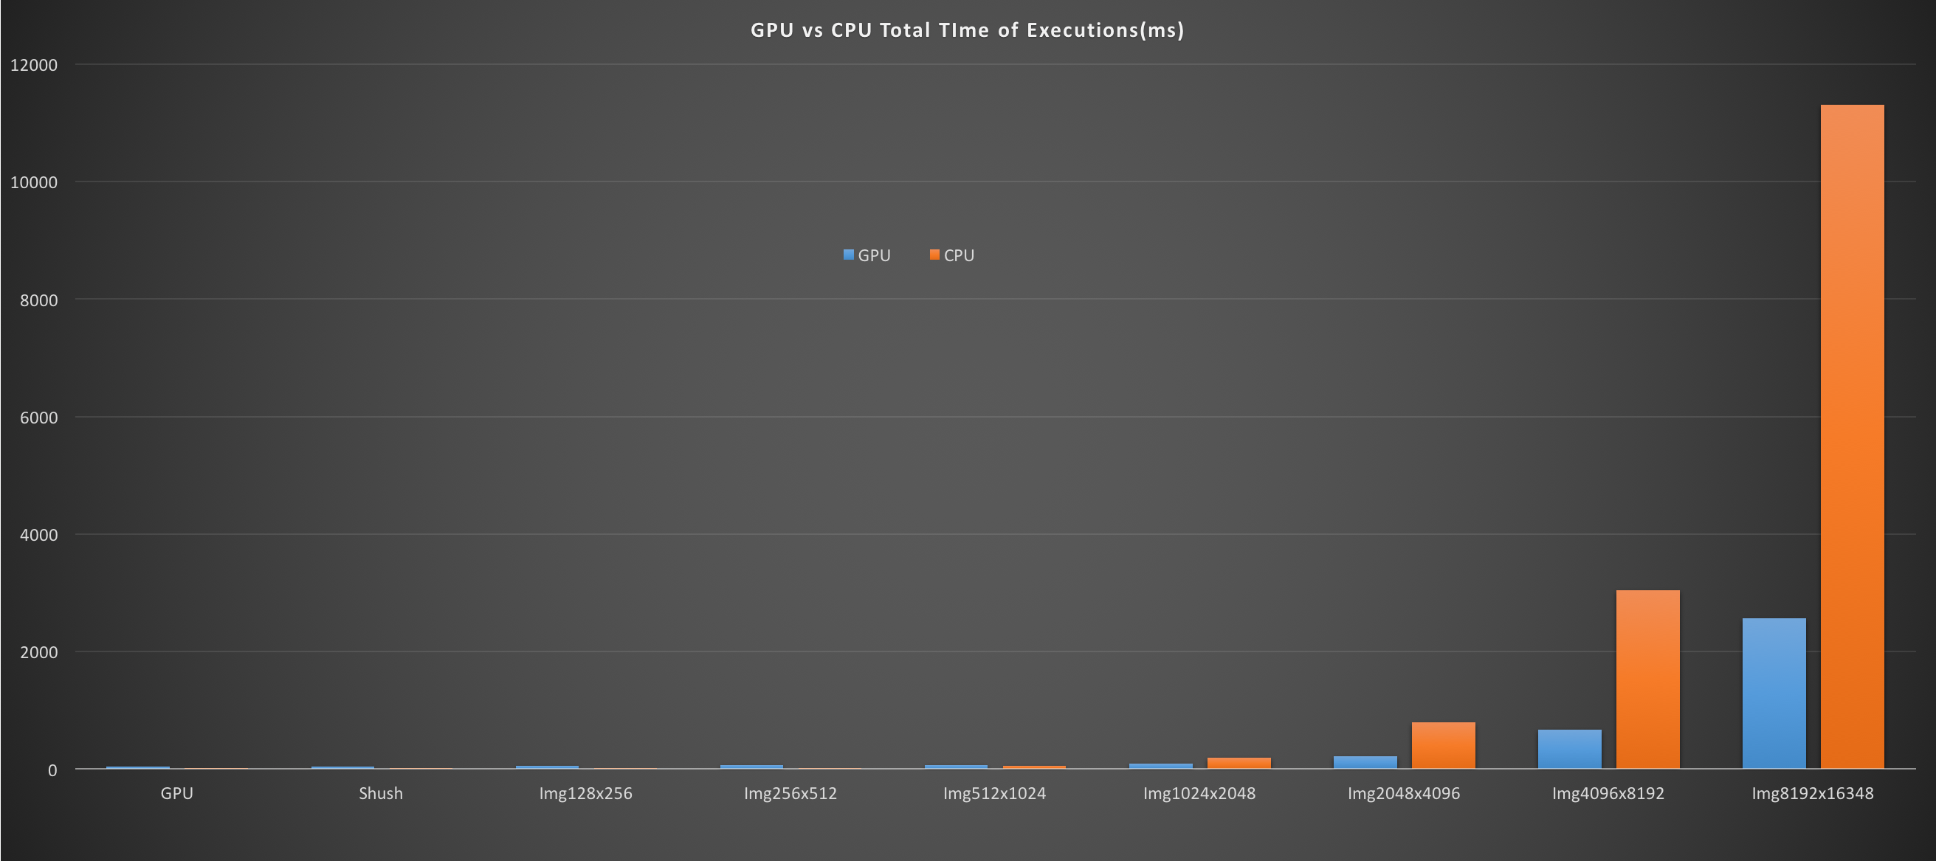
CPU Total Execution Times and the CPU total execution times are compared here
GPU | Shush | Img128x256 | Img256x512 | Img512x1024 | Img1024x2048 | Img2048x4096 | Img4096x8192 | Img8192x16348
45 | 48 | 62 | 65 | 68 | 93 | 214 | 669 | 2565
13 | 7 | 2 | 7 | 50 | 199 | 795 | 3044 | 11309

Slide 13
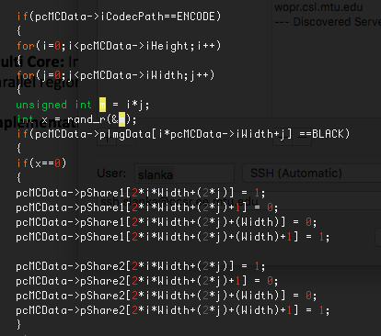
Multi Core: In multicore thread level Parallelism is exploited and every thread tend to execute the
Parallel regions independently. Thus achieving throughput.
Implementation:
Encoding:

Slide 14
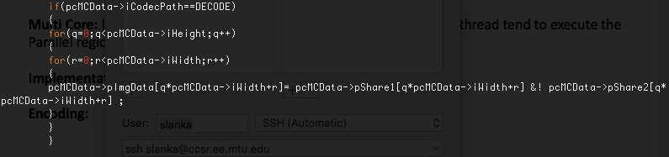
Implementation:
Decoding:

Slide 15
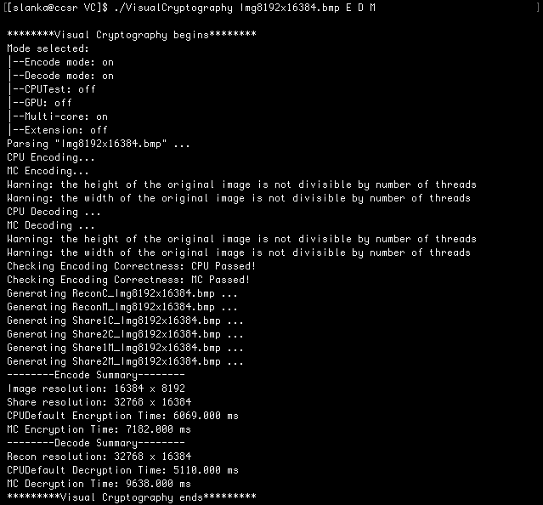
16 Threads are run at this instance

Slide 16
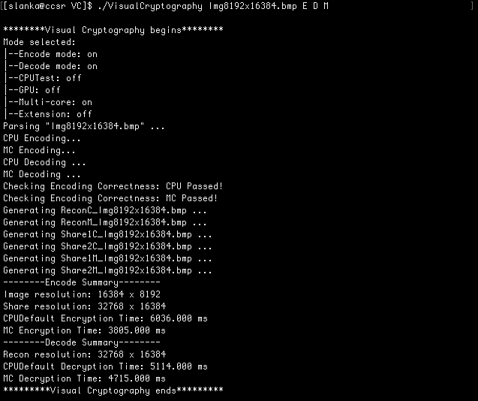
8 Threads are run at this instance

Slide 17
The optimal configuration is chosen by running the Largest Image on all the configurations
keeping the total thread number constant.
Number of threads | MC Encryption Time | MC Decryption Time | Total Time
1 | 3445 | 4737 | 8182
2 | 3477 | 4747 | 8224
4 | 3561 | 4745 | 8306
8 | 3805 | 4715 | 8520
16 | 7182 | 9638 | 16820
24 | 5077 | 3837 | 8914
32 | 9703 | 12501 | 22204
64 | 20218 | 24718 | 44936

Slide 18
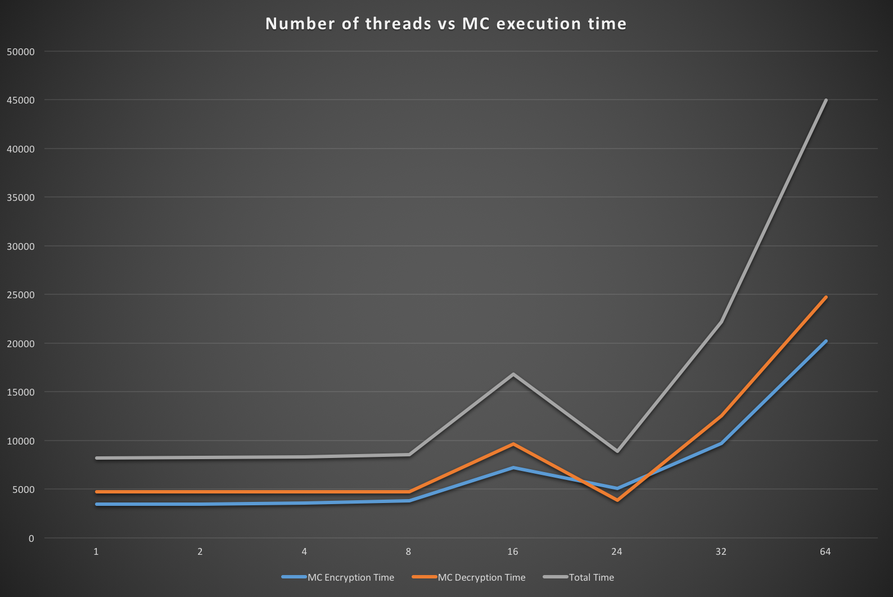
The optimal configuration is chosen by running the Largest Image on all the configurations
keeping the total thread number constant.

Slide 19
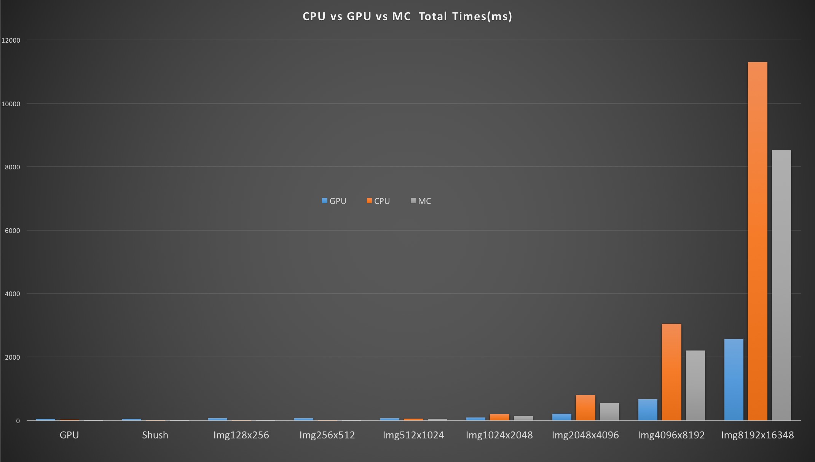
The time of executions of CPU vs GPU vs Multicore are tabulated and plotted for all the Images.
GPU | Shush | Img128x256 | Img256x512 | Img512x1024 | Img1024x2048 | Img2048x4096 | Img4096x8192 | Img8192x16348
45 | 48 | 62 | 65 | 68 | 93 | 214 | 669 | 2565
13 | 7 | 2 | 7 | 50 | 199 | 795 | 3044 | 11309
9 | 6 | 2 | 9 | 47 | 138 | 550 | 2198 | 8520
GPU
CPU
MC

Slide 20
CONCLUSIONS
GPU Performs well for large Images.
Multicore Outperforms GPU until the Image Img512x1024.bmp
GPU eventually performs better for larger workloads .
CPU is good for non parallel applications.

Slide 21
THANK YOU

